Slide 1


Town Hall
Janeen Latin
President/CEO
January 5, 2024

Slide 2
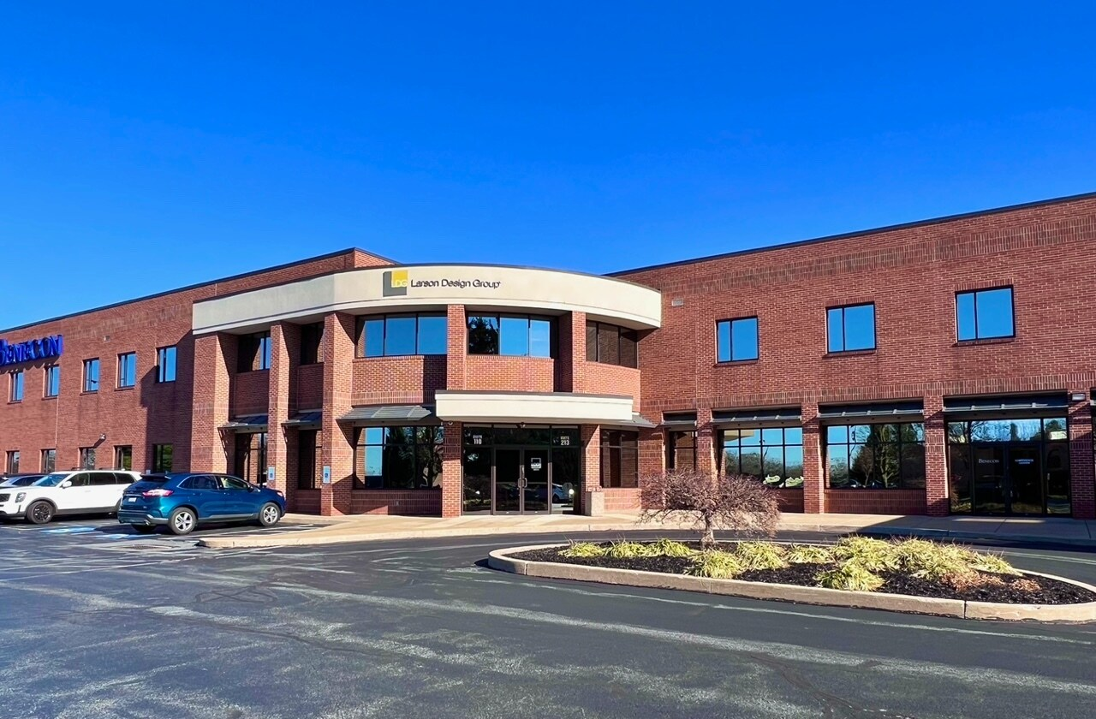
Things to know
Residential Acolades
CPS Consolidation
AWC Expansion
Selected for poster session at the ODP Everyday Lives Conference!
13 locations to 10 locations
Closing Lemoyne, Harrisburg West (6th St.), and Chambersburg effective February 22.
Why?
Create operational efficiencies and support sustainability through a reduction in fixed costs.
Lititz Office of Agency with Choice will open at the end of January.

Slide 3
Things to Know
Financial- July 2023-September 2023

Slide 4


Things to Know
Personnel
Less than 6 mo- 32% (20ppl)
Total Employees- 1617
Hires
Turnover
Admin-44
AWC-28 (SSPs 1,257)
Childhood & Ancillary-26
CPS-86
Employment & Community- 28
Residential-148
Since July 1, we hired 82 employees.
Admin-6
AWC-3 (196 SSPs)
Childhood & Ancillary-2
CPS-34
Employment & Community-7
Residential-30
60+ open positions
Since July 1, we lost 62 employees.
Admin-5
AWC-1 (238 SSPs)
Childhood & Ancillary-3
CPS-20
Employment & Community-4
Residential-29
Net Gain: 20

Slide 5

“People leave because of the accumulated emotions of everyday problems”
Areas to Grow*: Trust & Communication
Trust between employees and Leadership Team
Communication between supervisor and employees
Trust between employees and Division Leadership
Communication about changes departmentally
Communication between division leadership and employees
Keep these items in the back of your mind as you are interacting with your coworkers at UCP. We would love some more feedback in this area. Consider providing more information about how we can improve trust and communication through our electronic comment box, My 2 Cents at www.ucplistens.com *Reported by employees in the 2023 Engagement and Satisfaction Survey
Notes:
Testing Stay Interview Questions
What do you look forward to each day when you are driving to work?
What are you learning here? What do you want to learn?
Why do you stay here?
When is the last time you thought about leaving us and what prompted it?
What can I do to make your job better for you?

Slide 6

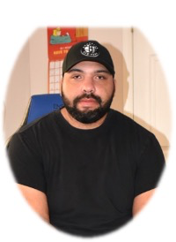
Career Pathfinder
Professional Development/Credentialing Opportunities for staff in ODP funded programs
About
Opportunities!
“I chose to enroll because I saw an opportunity to increase my knowledge in my field of work and while doing that, I got big bonuses and wage increases. It’s a win, win!”
Launched January 26, 2023
Credentialing funded through Office of Developmental Programs
Opportunity for bonus (ODP funded) and wage increase (UCP funded) for agency employees
NADSP- DSP I, II, III
NADSP- Front Line Supervisor
Charting the Life Course
SHIFT: Enabling Technology

Slide 7
What to Watch for in the coming months…
Picnic Survey
Communication Survey

Slide 8
Dates to Remember
June 15, UCP Sports Auction, Carousel Pavilion, Harrisburg City Island
Vol Ops
5
May 3- Employee Retreat, Vibrant
3
March 9- UCP Magic Night, black-tie dinner/dance, Colonial Golf & Tennis Club
Vol Ops
1
July- Summer Carnival, 55 Utley, TBD
6
March 14- Town Hall Mtg. 9:30, 3:30
2
June 13- Town Hall Mtg. 9:30, 3:30
4

Slide 9
How you can help…
Refer a Friend to work at UCP… you could receive $1,000 for EACH referral!
Share jobs on social media
Volunteer for Magic Night, contact Terri Dorsey, terri.dorsey@ucpcentralpa.org
Purchase UCP socks!

Slide 10

Order TODAY!

Slide 11
Questions?

